Slide 1
Decision Tree Algorithms in Machine Learning
A clear, visual guide to understanding one of the most intuitive and powerful algorithms in data science

Slide 2
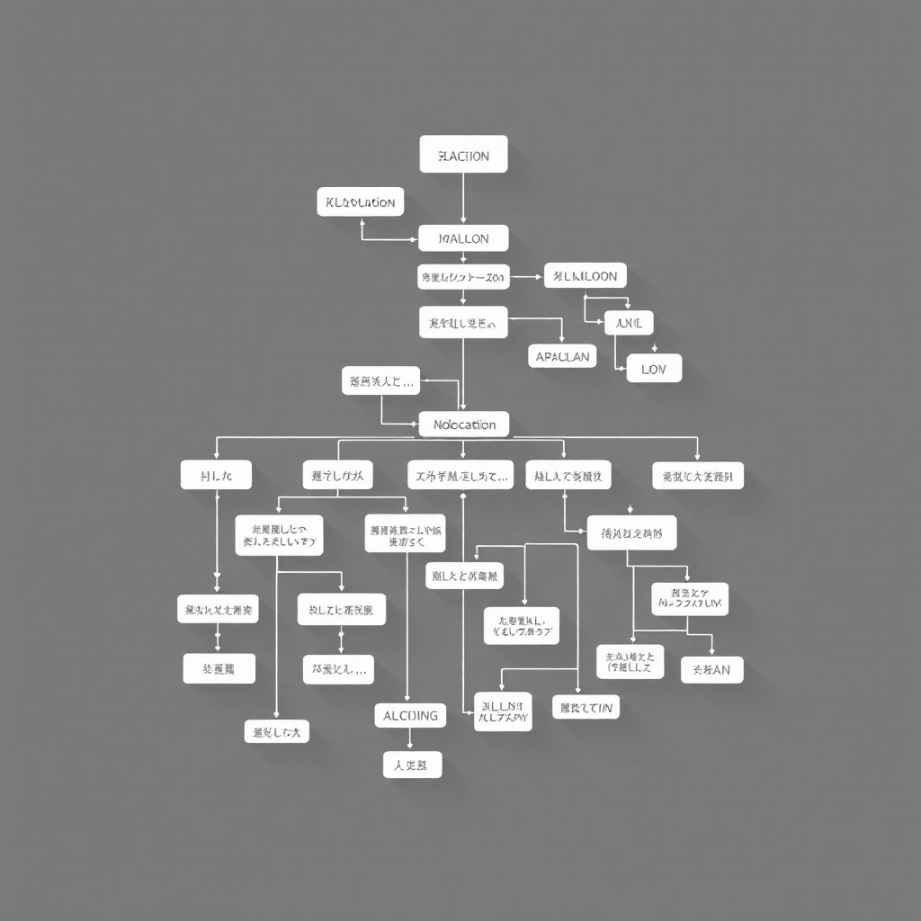
What is a Decision Tree?
A decision tree is a supervised learning algorithm that mimics human decision-making by breaking down complex choices into a series of simple questions. It's structured like a flowchart, making it one of the most intuitive machine learning models.
The algorithm works by splitting data step-by-step based on feature values, creating a tree-like structure that leads to predictions. It's versatile enough to handle both classification tasks (predicting categories) and regression problems (predicting continuous values).

Slide 3
Anatomy of a Decision Tree
Root Node
The starting point containing the entire dataset. This is where the first question is asked to begin splitting the data.
The root node is the topmost node of the tree.
It represents the entire dataset, and the algorithm chooses a feature (attribute) that best splits the data into groups (based on criteria like Information Gain, Gini Index, or Chi-square).
It’s the starting point for decision-making.
Example:
In a weather dataset, the root node might split on “Outlook” (Sunny, Rainy, Overcast) to begin classification for whether to “Play Tennis” or not.

Slide 4
Decision Nodes OR Internal nodes
These are the internal nodes of the tree where splitting occurs.
Each node represents a test on a feature, and each branch from that node corresponds to a possible outcome of the test.
Decision nodes are where the tree branches out further based on different feature values.
Feature-based decision points that ask questions and split the data into smaller, more homogeneous group
Example:
If the root node is “Outlook,” a decision node might be “Humidity” or “Wind” depending on the next best attribute to split the data.

Slide 5
Branches
The paths representing possible answers to questions, connecting parent nodes to their children.
Branches (also called edges) are the connections between nodes.
Each branch represents a decision rule or outcome of a feature test.
They guide how data flows from the root to a leaf.
Example:
If the node tests “Humidity,” one branch may represent “Humidity ≤ 75%” and another “Humidity > 75%.”

Slide 6
Leaf Nodes
Terminal nodes containing the final decision or prediction outcome. No further splitting occurs here.
Leaf nodes are the endpoints of the tree — they do not split further.
Each leaf node gives the final output or prediction (e.g., a class label or a numeric value).
In classification: represents a class (e.g., Yes or No).
In regression: represents a predicted value (e.g., House price = ₹45 lakh).
Example:
If all conditions lead to a subset where all examples belong to “Play = Yes,” then that leaf node predicts “Yes.”

Slide 7
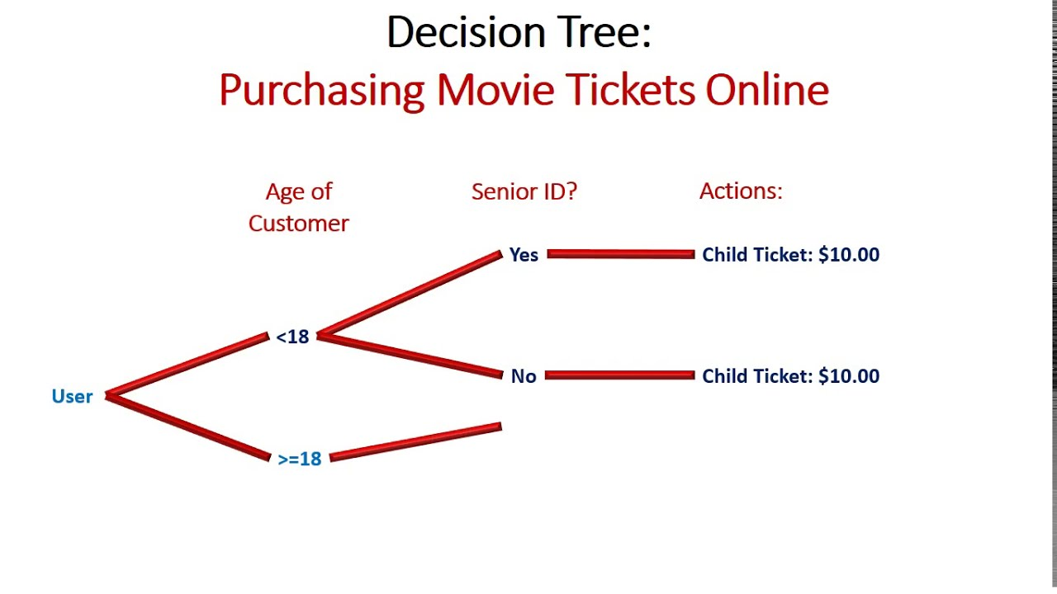
How Does a Decision Tree Work?
Root Question
Is income > $50,000?
The algorithm starts by asking the most informative question about the customer's income level.
Branch Decision
If No → Predict "No Purchase"
If Yes → Continue to next question: "Is age > 30?"
Refine Prediction
For customers with age > 30, check: "Any previous purchases?"
Yes → Predict "Purchase" | No → Predict "No Purchase"

Slide 8
Key Concepts: Entropy & Information Gain
High Entropy
Understanding the Math Behind Splits
Entropy measures the uncertainty or impurity in your data. High entropy means mixed classes; low entropy means pure groups. The formula quantifies disorder in the dataset.
Calculate Information Gain
Information Gain calculates the reduction in entropy after making a split. The feature that provides the highest information gain becomes the splitting criterion.
When a perfect split is achieved, entropy drops to zero, giving you crystal-clear classification with no ambiguity.
Low Entropy

Slide 9

Entropy – Measure of Impurity or Disorder
Entropy quantifies uncertainty or impurity in a dataset.
It tells us how mixed the data is in terms of class labels.
Intuition:
If all samples belong to the same class, there’s no uncertainty → Entropy = 0.
If samples are evenly split among classes, uncertainty is maximum → Entropy = 1 (for binary classes).
Formula (for binary classification):
$$Entropy\left(S\right)=−p_{1}{\log{}}_{2}\left(p_{1}\right)−p_{2}{\log{}}_{2}\left(p_{2}\right)$$
where:
$p_{1}$= proportion of Class 1
$p_{2}$= proportion of Class 2
For multiple classes:
$$Entropy\left(S\right)=−\sum_{i=1}^{n}{p_{i}}{\log{}}_{2}\left(p_{i}\right)$$

Slide 10

Example:
Suppose a dataset has 10 samples:
6 belong to Class A
4 belong to Class B
$$Entropy=−\left(0.6\right){\log{}}_{2}\left(0.6\right)−\left(0.4\right){\log{}}_{2}\left(0.4\right)$$
$$Entropy=0.971$$
The entropy is close to 1, so the dataset is fairly impure.

Slide 11

Information Gain – Reduction in Entropy
Information Gain (IG) tells us how much “information” a feature gives us about the class labels.
In other words, it measures how much uncertainty decreases when we split the data based on a feature.
Formula:
$$InformationGain\left(S , A\right)=Entropy\left(S\right)−\sum_{v∈Values\left(A\right)}{\frac{∣S_{v}∣}{∣S∣}}×Entropy\left(S_{v}\right)$$
where:
$S$= parent dataset
$A$= attribute (feature)
$S_{v}$= subset of $S$for which attribute $A$has value $v$

Slide 12

Intuition:
The feature with the highest Information Gain gives the most effective split.
Decision Trees (like ID3 and C4.5) use Information Gain to choose the best feature at each node.
Example:
Let’s say before splitting, entropy = 0.971.
After splitting by “Weather” (e.g., Sunny, Rainy), the weighted average entropy of child nodes = 0.5.
$$InformationGain=0.971−0.5=0.471$$
“Weather” gives us 0.471 bits of information, reducing uncertainty significantly.

Slide 13
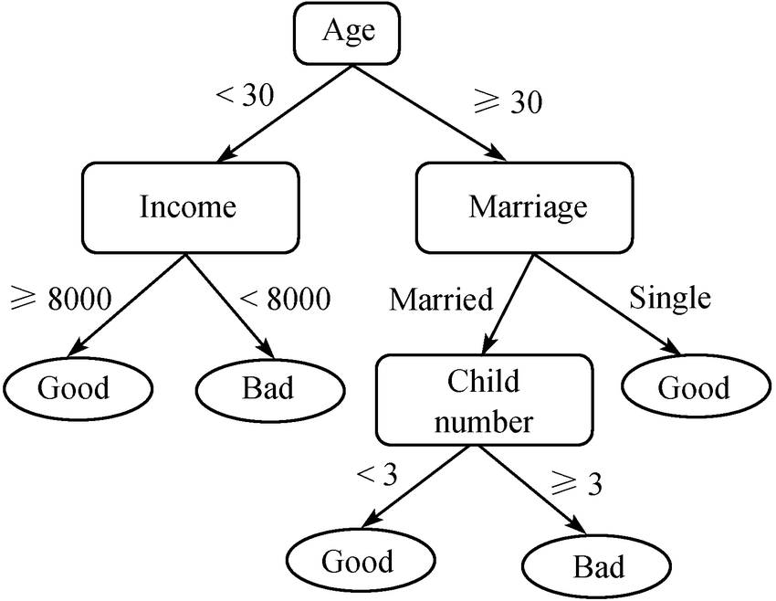
Types of Decision Trees Classification Trees Designed to predict discrete categories or class labels. Perfect for yes/no decisions, customer segments, or disease diagnosis.
Used for: Categorical target variables (e.g., Yes/No, Spam/Not Spam, Disease/No Disease)
Goal: To classify data into discrete classes.
Splitting Criteria: Measures like
Gini Index
Entropy / Information Gain
Chi-square

Slide 14
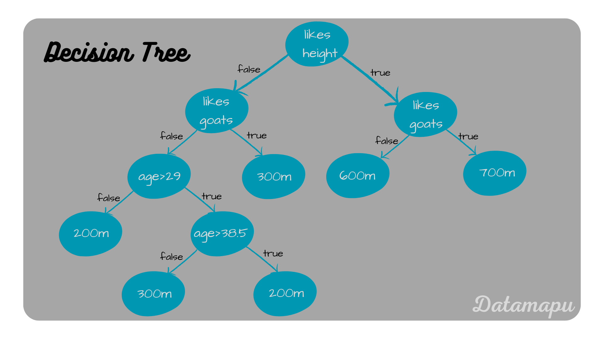
Regression Trees
Built to predict continuous numerical values. Ideal for forecasting quantities, prices, or measurements.
Used for: Continuous target variables (e.g., Price, Salary, Temperature)
Goal: To predict numerical values.
Splitting Criteria:
Variance reduction
Mean Squared Error (MSE)
Example:
Predicting the price of a house based on area, location, and number of rooms.

Slide 15
Advantages of Decision Trees
Highly Interpretable
Easy to understand, explain, and visualize. Non-technical stakeholders can follow the decision logic without difficulty.
Minimal Preprocessing
Requires little data preparation. No need for normalization or scaling. Missing values can be handled naturally.
Versatile Data Handling
Works seamlessly with both numerical and categorical features without conversion or encoding.
Fast Predictions
Achieves logarithmic time complexity for predictions, making it efficient even with large datasets.

Slide 16
Challenges & Limitations
Overfitting Risk
Decision trees are highly susceptible to overfitting, especially when allowed to grow to full depth without pruning. This means the tree learns the training data, including noise and outliers, too well and performs poorly on unseen data.
Model Instability and High Variance
Small changes in the training data, such as adding or removing a few data points or features, can lead to significant changes in the tree structure and the resulting predictions. This instability makes decision trees less robust and can hinder their generalization ability.

Slide 17
Difficulty in Capturing Complex Relationships:
Decision trees construct piecewise constant approximations of the underlying function. This makes them less effective at capturing complex, non-linear relationships or interactions between features, which are often present in real-world data.
Bias towards Features with Many Categories:
Decision trees can exhibit a bias towards features with a large number of distinct values or categories. The splitting criteria, such as information gain, might favor these features, potentially leading to suboptimal splits and reduced accuracy.
Imbalanced Datasets:
Decision trees can be biased towards the majority class in imbalanced datasets, leading to poor performance on the minority class. Techniques like class weighting or resampling are often required to address this.

Slide 18
Computational Expense for Large Datasets:
Building and pruning deep decision trees on very large datasets can be computationally intensive and time-consuming, especially as the number of features and data points increases.
Greedy Nature of Algorithm:
Most decision tree algorithms use a greedy approach, making locally optimal decisions at each split. This does not guarantee a globally optimal tree and can lead to suboptimal solutions in some cases.
Limitations in Regression Problems:
In regression tasks, decision trees produce piecewise constant predictions, which can struggle to accurately approximate continuous functions and extrapolate beyond the range of the training data.

Slide 19
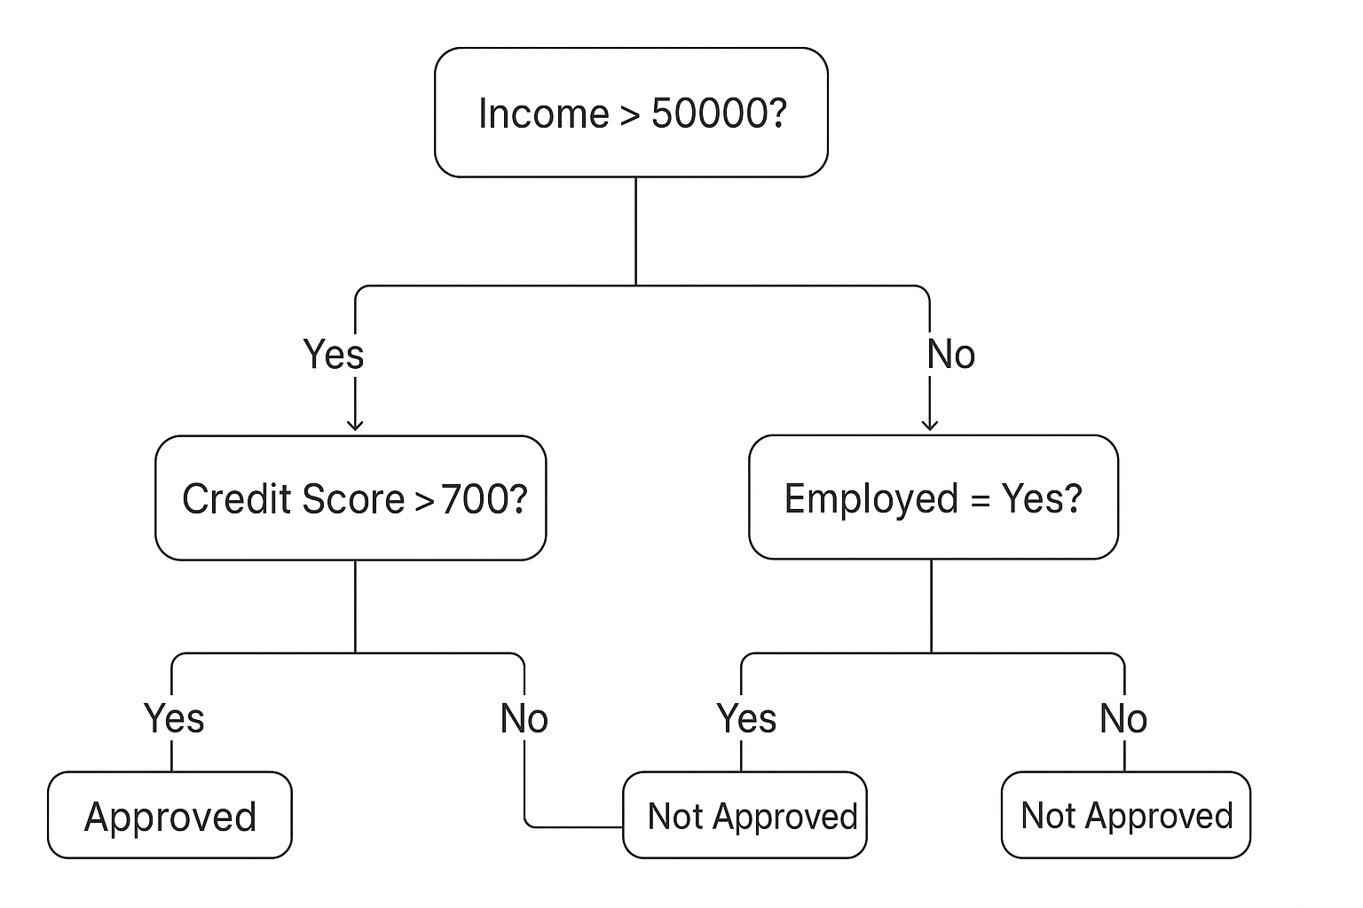
Real-Time Example: Loan Approval Prediction
The decision tree would be built using historical data of past loan applicants, including features like:
Credit Score: (e.g., High, Medium, Low)
Income: (e.g., High, Medium, Low)
Employment Status: (e.g., Employed, Unemployed)
Loan Amount: (e.g., Large, Small)
Loan Default: (Yes/No - this is the target variable)

Slide 20
How the Decision Tree Works:
Root Node:
The tree starts with a root node, which might be the most influential feature, such as "Credit Score."
Splits:
The data is then split based on the credit score. For example, one branch for "High Credit Score," another for "Medium Credit Score," and a third for "Low Credit Score."
Subsequent Nodes:
Each branch then leads to another decision node, testing another feature. For instance, if the credit score is "High," the next node might test "Income."
Leaf Nodes:
This process continues until a leaf node is reached, which represents the final decision – "Loan Approved" or "Loan Denied."

Slide 21
Example Path:
Applicant A: High Credit Score -> High Income -> Employed -> Loan Approved.
Applicant B: Low Credit Score -> Unemployed -> Loan Denied.

